Slide 1

SciX Online Summer Programs
Grades 9-12: Plots and Points

Slide 2
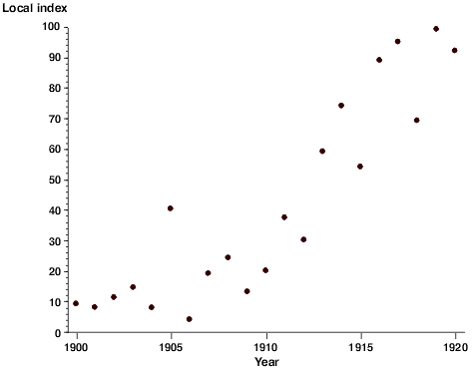
Introduction
Whenever a computer draws an image on the screen, it must tell each pixel to turn a specific colour
Computer scientists use graphs and plots to do this
Notes:
As a programmer, we need a way to refer to specific pixels or points on the screen. Computer scientists use graphs and plots to do this.

Slide 3
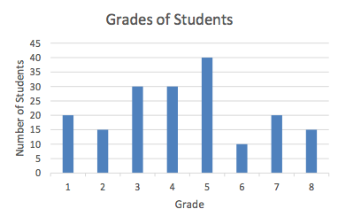
Graphs and Plotting Points
Two Axes
Horizontal: grade of student
Vertical: number of students in grade
How many students in the 4th grade?
Notes:
Students are likely familiar with graphing from school
Consider a bar graph that graphs two numerical axes
For example, a graph comparing how many students are in each grade in a school
This bar graph has two axes: a horizontal axis referring to the grade of the students, and a vertical axis referring to the number of students in each grade. We can read a bar graph by looking at the top of each bar. If we want to know how many students are in grade 4, we can look at the top of the grade 4 bar and see which number of students is at the same height (30 students).

Slide 4
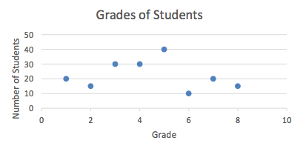
We could replace the bars with dots marking the tops of the bars, called a plot:
Notes:
When we represent data with points like this, we call the graph a plot
We read this plot the same way that we read the bar graph
To find how many students are in grade 5, find the point above the 5 on the horizontal axis, and see which number on the vertical axis it is in line with (40).

Slide 5
Coordinates
Instead of drawing a point at the intersection of grade 5 and 40 students, we write (5, 40) = coordinate
“5 along the horizontal axis and 40 along the vertical axis”
Represent entire graph with just coordinates: (1, 20), (2, 15), (3, 30), (4, 30), (5, 40), (6, 10), (7, 20), (8, 15)
Notes:
We can write this data in an even more simple way
Instead of drawing it, we could write the data as numbers
Instead of drawing a point at the intersection of grade 5 and 40 students, we write (5, 40)
This is called a coordinate and it means “5 along the horizontal axis and 40 along the vertical axis”
It helps to think of a coordinate as instructions how to get from the bottom-left corner of the graph to the point (5 right and 40 up)

Slide 6
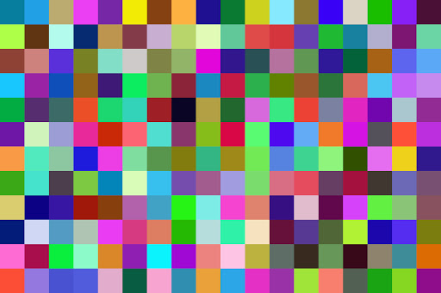
Representing the Screen as a Plot
Monitor = grid of pixels, we can refer to them with coordinates
For example, pixel(40, 200) would refer to the pixel that is the 40th pixel across the screen and the 200th pixel down the screen
Notes:
We started this lesson trying to find a way to refer to specific pixels
Since a monitor is a grid of pixels, we can refer to them with coordinates
For example, pixel(40, 200) would refer to the pixel that is the 40th pixel across the screen and the 200th pixel down the screen
Your computer tells individual pixels to change colour using this method.

Slide 7
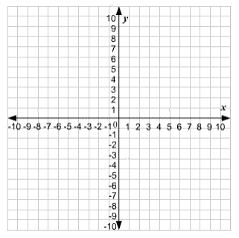
Negative Values
We can extend the graph's axes to include negative numbers
point (0, 0): origin
Notes:
What happens in we want to graph negative values (for example, graphing temperature over time)
We can extend the graph’s axes to include negative numbers. When we do this, we get a graph with 4 “corners”
We can refer to points on this graph with coordinates in the same way
The most important point on any graph is the point (0, 0), called the origin
Usually, when we draw images in computer science, we put the origin in the middle of the screen so we can use positive and negative values

Slide 8
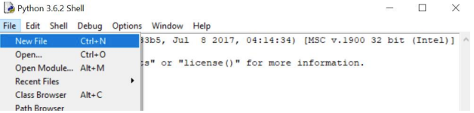
Python and Turtle
For this activity, we will be using Python, and a part of this language called turtle
Start by opening the Python editor – IDLE. Click File > New File to create a new file

Slide 9
Python and Turtle
In the new file, type: import turtle
This tells python that we are going to be using turtle
We can use lines of code to tell the turtle to move to different areas of the screen
Start with: turtle.setposition(0, 0)
Notes:
This function tells the turtle to move to a specific position, in the brackets we can write the coordinates.

Slide 10
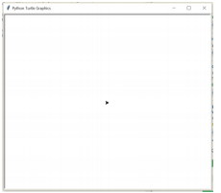
Python and Turtle
Press Run > Run Module to run the program. A window will appear:
Notes:
We can see that the turtle has moved to the position (0, 0) at the center of the screen.

Slide 11
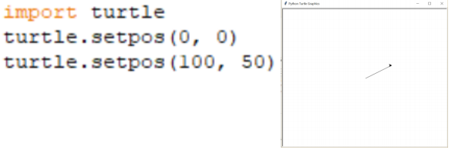
Python and Turtle
Then the line turtle.setposition(100, 50) This moves the turtle to the coordinate (100, 50) and draws it’s path as it moves:

Slide 12
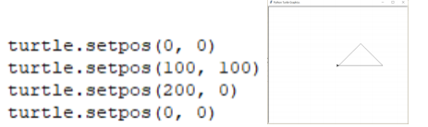
Python and Turtle
Use the setposition() function to create more shapes and images with turtle
Triangle

Slide 13
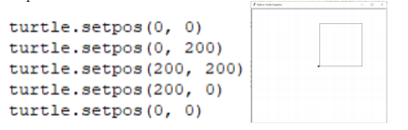
Python and Turtle
Use the setposition() function to create more shapes and images with turtle
Square

Slide 14
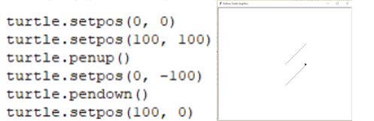
Python and Turtle
turtle.penup() and turtle.pendown() are used to stop the turtle from drawing as it moves:

Slide 15
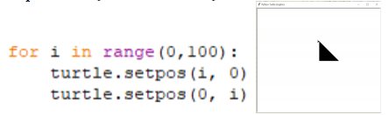
Python and Turtle
Loops – “for loops” can be used to repeat some code but with a different number each time:
Notes:
This loop runs 100 times
Each time it loops the variable “i” increases by 1 (it starts at 0 and goes up to 100)
The indented lines below it run each loop
So, the turtle’s path is (0, 0), (0, 0), (1, 0), (0, 1), (2, 0), (0, 2), (3, 0), (0, 3), etc…
Students can play around with these numbers to make different shapes. In stead of “i” as the coordinate, try “i*2”, or “i%10”, or try changing the numbers in the range.

